Slide 1
Hydrological Modeling
Theo Lim
GI Studio Guest Lecture
9/16/16
Notes:
Broad Definition:
“The study of the properties of the earth’s water, especially its movement in relation to land”
- Often includes spatial distribution (how much water stored in the ground, how much on the surface, how much in vegetation, in pipes, loading to a wastewater treatment plant, distributed to cities, etc), temporal (inter-annual variations/cycles, seasonal variations/cycles, in the case of infrastructure loading – not conventionally thought of as “hydrology” but could have diurnal cycles, in response to wet weather events), and water quality (“the solution to pollution is dilution”)

Slide 2
Goals
Increase familiarity with urban hydrological cycle: “Hydrologic literacy”
Introduce advantages and shortcomings of urban hydrological modeling
Build working knowledge of a lumped-parameter design storm model

Slide 3
Overview
Why model?
What are we trying to model?
Approaches to modeling
Types of models relevant to Green Stormwater Infrastructure
Creating Hydrographs Using the SCS method
HydroCAD demo

Slide 4
Why Model?
“All models are wrong, but some are useful” – George Box, statistician
What do we model?
Who is doing modeling?
When do we model?
Notes:
Discussion: for each of these, what are modelers’ motivations? What components do you think they will be interested in? What do you think they are trying to achieve?
Relationship between modeling and monitoring
Think about scale
Think about spatial extent, temporal extent – to what extent do we care about timing?

Slide 5
Why Model?
“All models are wrong, but some are useful” – George Box, statistician
Who models and when?
Infrastructure managers/planners → regulatory agencies
Infrastructure managers/planners → investment decision-making
Site designers/developers/engineers → compliance and site permitting (usually involved after Schematic Design)
Regional environmental planners and watershed managers → regulatory body
Academics and researchers → publications, policies, new knowledge
Notes:
Discussion: for each of these, what are modelers’ motivations? What components do you think they will be interested in? What do you think they are trying to achieve?
- Relationship between modeling and monitoring

Slide 6
Discussion: What do we want out of modeling? How will we interact with hydrological models?
Notes:
Think about your possible career – where/how do you see yourself interfacing with hydrological modeling
Purpose: understand where students are coming from, be able to speak to their interests.

Slide 7
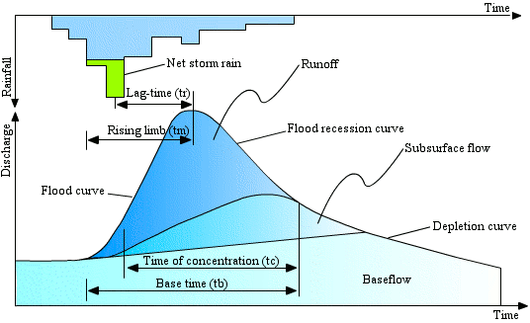
Discussion: What do we want out of modeling?
Notes:
Talk through the components of this
Rainfall hyetograph – usually depicted as bars. This can refer to volumes OR rate (intensity)
Green part: “precipitation excess”
Note the curvilinear shape of the hydrograph (could be normalized by area, or a flow rate , eg: cfs)
Time of concentration - time to point of inflection in the recession limb – when flow rate starts decreasing more slowly.
Lag time – time to peak
Note: terminology: “runoff” vs “quickflow”
We will look at some more diagrams in a few slides. Point: different modelers may choose to focus on different areas of this diagram.

Slide 8
The Overall Modeling Process
The Perceptual Model:
Deciding on the Processes
The Conceptual Model:
Deciding on the Equations
The Procedural Model:
Getting the Code to Run on a Computer
Model Calibration:
Getting values of the parameters
Model Validation:
A good idea but difficult in practice
Revise perceptions
Revise equations
Debug code
Check for data errors, revise parameter values
Adapted from Beven 2012
Notes:
Ideally, should view modeling as a tool for learning about the system. That means that the “act” of modeling should definitely be iterative.
In a regulatory environment, the choice of perceptual model is often prescribed. Start at “The Procedural Model”, so many modelers may not think about what processes may be missing.
Example: in urban hydrological modeling, focus of last 20 years has mostly been on surface runoff – impervious surface as blocking subsurface storage capacity of watersheds. So we model impervious surface – directly connected and non directly connected impervious surface. Our policy intervention is: let’s disconnect impervious surface. But: is this really what is happening?
Omitted Variable Bias in statistical modeling.

Slide 9
Modeling in the Site Design Process
Conceptual Design
Schematic Design
Detailed Design
Construction Documents
Notes:
In which part of the design process is the modeling taking place? Is there potential to incorporate innovative design? Or is the design process only to meet some prescriptive metric?
I include this slide bc while you are working on public infrastructure improvements, much of stormwater management is based on the site-scale and driven by new development regulation.
As planners, when do you choose to bring in infrastructure design. This can have a real impact on innovation, finding synergies and making the ‘business case’ for green infrastructure innovation.
Tell eco-district story

Slide 10
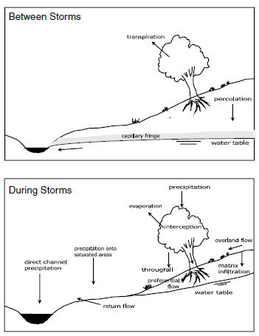
What are we trying to model?
Dominant processes in un-urbanized catchments in humid climates
Source: Beven 2012
Notes:
Different perspectives will approach what they want to model differently
Baseflow and quickflow of streams

Slide 11
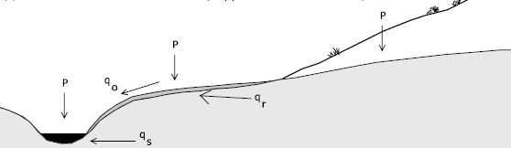
What are we trying to model?
Dominant processes in un-urbanized catchments in humid climates
Note: “Q” is the conventional variable for flow [L³ T⁻¹]
(overland flow)
(return flow)
(subsurface flow)
Source: Beven 2012
Notes:
Different perspectives will approach what they want to model differently
Note: what is not shown here is overland flow that occurs when rainfall intensity exceeds infiltration rate.

Slide 12
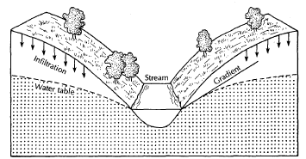
What are we trying to model?
Dominant processes in un-urbanized catchments in humid climates
Source: Fetter 2001

Slide 13
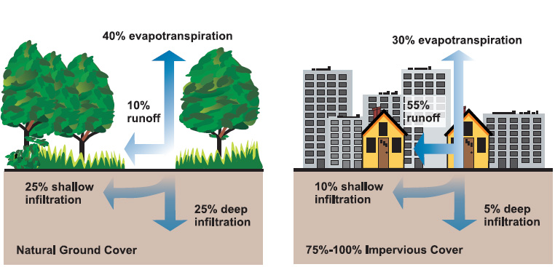
What are we trying to model?
Dominant processes in URBANIZED catchments in humid climates
Source: US EPA 2003
Notes:
Different perspectives will approach what they want to model differently
Here is what I was talking about with Hortonian Overland Flow.

Slide 14
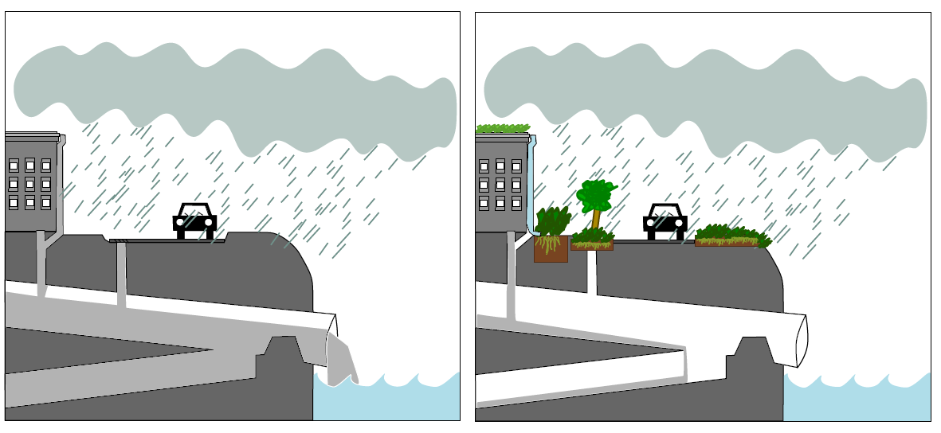
What are we trying to model?
Dominant processes in URBANIZED catchments in humid climates
Source: Lim 2014
Notes:
Different perspectives will approach what they want to model differently

Slide 15
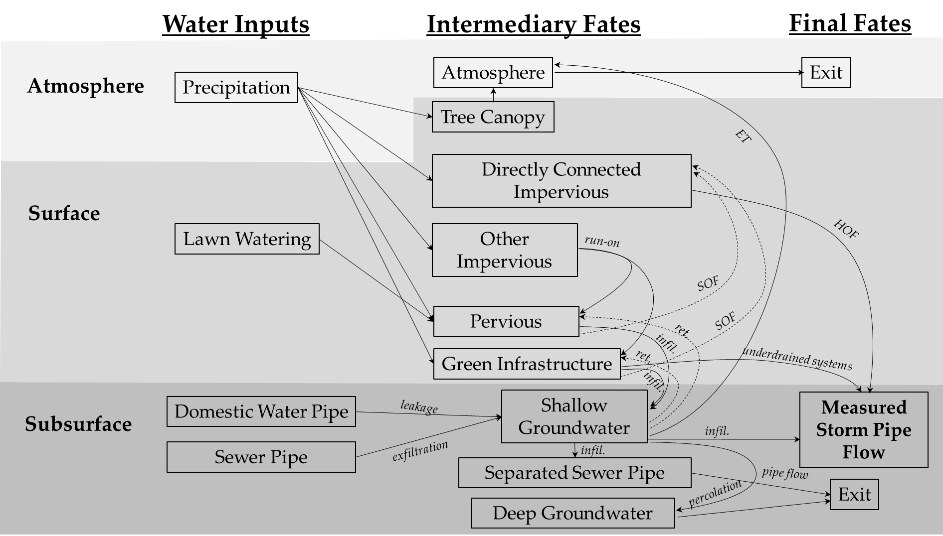
Elements of the Urban Hydrologic Cycle
Source: Lim 2015
Notes:
Dashed lines – unintended fates that could lead to reduced hydrological effectiveness of GI from expected
SOF = Saturated Overland Flow
HOF = Hortonian Overland Flow (precipitation intensity exceeds infiltration rate)
Draw attention to interactions between other infrastructures, return flow, direction of saturated overland flow
POINT: have an idea of how the overall system operates, and try to represent. Systems can be quite complex.

Slide 16
Approaches to Modeling
LUMPED: Treats catchment as a single unit, state variables represent catchment averages over the entire area
DISTRIBUTED: Discretizes catchment into grid cells, state variables are assigned to each grid and related to each other through physical process equations, sometimes called “process-based” or “physically-based” models

Slide 17
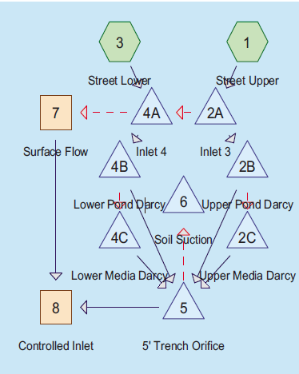
Approaches to Modeling
HydroCAD is an example of a lumped parameter, edge-node model. Each node represents a “catchment” with its own storage, porosity, conductivity etc parameters
Source: Lucas 2010
Notes:
Routing between areas that produce runoff, and various “ponds” and other storage or conveyance areas

Slide 18
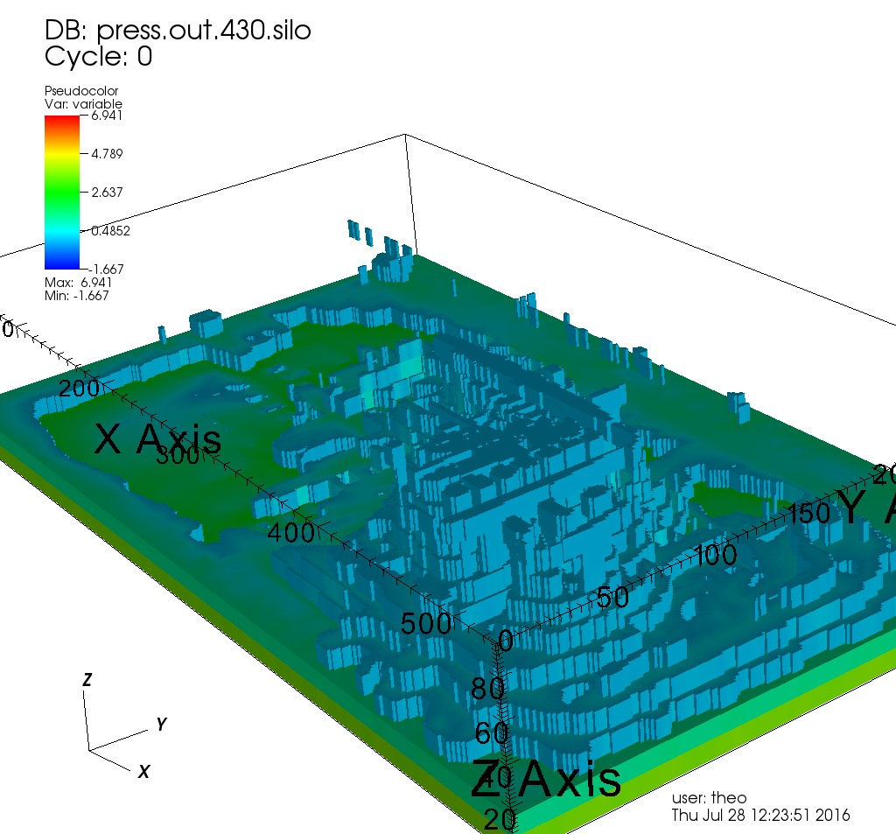
Approaches to Modeling
ParFlow-CLM is an example of a fully-distributed, finite-difference model model. In this example, the horizontal gridding is 1.5m x 1.5m, with variable dz discretization in the z dimension. Continuous solutions to Richards equation for the pressure field are solved using a numerical solver, called KINSOL.
Source: Lim 2016

Slide 19
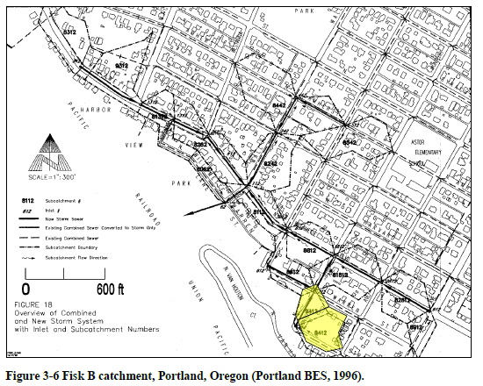
Approaches to Modeling
SWMM is generally classified as a lumped parameter model, but what would happen if you make the “catchments” really small?
Source: Rossman 2015

Slide 20
Approaches to Modeling
BOTTOM-UP: This is primarily what we have been talking about and what most people are referring to when they talk about “hydrological modeling.” Modelers are interested in running simulations given known relationships between parameters (equations), given some actual or hypothetical scenarios.
TOP-DOWN: Another approach to determining if our perceptual models of hydrological function are supported by empirical evidence. When might we take a top-down modeling approach?

Slide 21
Approaches to Modeling
More on top-down modeling later…
Back to bottom-up types now…

Slide 22
Approaches to Modeling
 | Key Concepts | Examples
Rainfall-runoff calculation | Peak flow Q = CiA | The Rational Method
Hydrologic | Rainfall-runoff simulation plus reservoir/channel routing (TIME and SPACE) | TR-55, HEC-HMS (SCS method), ParFlow, RHESYS
Hydraulic | Flow rates, and flow velocities through waterways, structures and pipes | HEC-RAS
Combined Hydrologic-Hydraulic | Hydrologic outputs used as inputs to hydraulic model | SWMM, HydroCAD
Water Quality | Mass loading, dispersion, advection, etc | WASP
http://stormwater.pca.state.mn.us/index.php/Available_stormwater_models_and_selecting_a_model
Notes:
Hydrologic modeling: study of prcp and water in connection to geography and geology
Hydraulic modeling: study of motion of liquids – relates to fluid mechanics. Applied in pressurized pipes, pipe flow, dam design, computational fluid dynamics, flow measurement, river channel behavior
Hydrologic ROUTING
Hydraulic ROUTING -

Slide 23
Re-focus: What are we trying to model?
Dominant processes in in response to rainfall
Source: Fetter 2001
Source: US EPA 2003
Notes:
Different perspectives will approach what they want to model differently

Slide 24
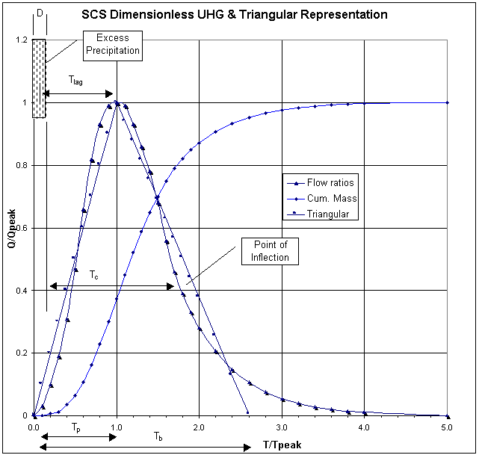
Back to: What are we trying to model?
Dominant processes in in response to rainfall
Notes:
Want: to input rain fall depths and timing, and be able to predict timing, peak discharge (flow), and total volumes of response as measured at some discrete point downstream. Ie, rainfall response that is defined in time and space.

Slide 25
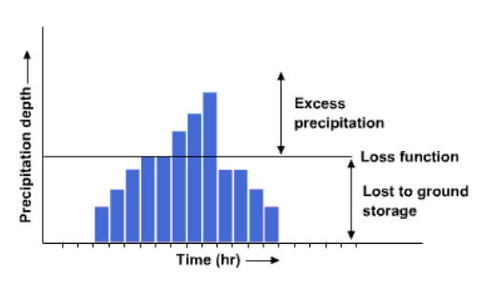
Infiltration and Surface Runoff
Logic:
Precipitation Rate
(Timing of a Volume)
Infiltration Capacity Models, sometimes called “loss models”, or “initial abstraction”
Precipitation Excess
(a Volume)
Timing of Runoff, or creating of a streamflow hydrograph
(Timing of the Volume)

Slide 26
Infiltration and Surface Runoff
Thoughts on hydrographs
What would be the effect of steeper slopes in the catchment area?
What would be the effect of rougher surfaces?
What would the effect of an elongated basin shape be?
Notes:
Steeper slopes:

Slide 27
Runoff Curve Number
For calculating direct runoff from rainfall excess
Notes:
Det ponds don’t reduce volumes, just knocks the peaks down
Simply managing peak volumes at the site boundary may not be sufficient
Many LID: try to reduce volume through infiltration, evapotranspiration

Slide 28
Peak, Peak Delay, Volume-Based Designs
Detention Ponds
Notes:
Det ponds don’t reduce volumes, just knocks the peaks down
Simply managing peak volumes at the site boundary may not be sufficient
Many LID: try to reduce volume through infiltration, evapotranspiration

Slide 29
The Unit Hydrograph
This is like the “normal distribution” of surface runoff models
Constructed from empirical data averaging the area and precipitation-normalized hydrographs from many (un-developed), small watersheds
Easy to compute from geographic parameters -> define “lag time”
Nice curvilinear shape
Notes:
Gives pretty good results if assumptions are met. Can be calibrated (correction factors) if have empirical data
Nice inflection points
Based on triangular shape
Just have to calculate lag time

Slide 30
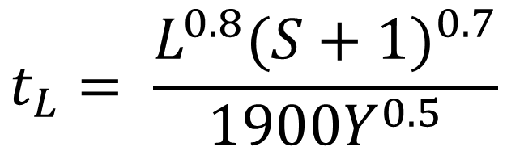
The Unit Hydrograph
Time lag is calculated from geomorphic characteristics of the catchment area
$$t_{L}= \frac{L^{0.8}{(S+1)}^{0.7}}{1900Y^{0.5}}$$
L = Hydraulic length (ft)
Y = slope (%)
S = potential max retention (inches)
Notes:
Shape of the hydrograph is based on time to peak, inflection points based on averaged ratios
Tc is end of rainfall to point of inflection
Storage is a function of the Curve Number
Y is watershed slope (steeper: decreases lag time)
L : Hydraulic length: pathway from furthest point in watershed to discharge point, including sheetflow, shallow channelized flow, stream flow
Good rule of thumb, if flow path greater than 300 ft, will start to channelize
Note: it’s not furthest as the crow flies, water meanders

Slide 31
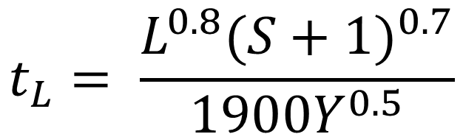
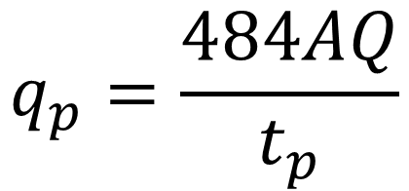


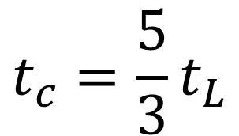
Calculating Peak Discharge
$$t_{L}= \frac{L^{0.8}{(S+1)}^{0.7}}{1900Y^{0.5}}$$
$$t_{c}=\frac{5}{3}t_{L}$$
$$t_{P}=0.67t_{c}$$
$$P_{e}=Q$$
General Desc | Peaking Factor | Limb Ratio
Urban areas; steep slopes | 575 | 1.25
Typical SCS | 484 | 1.67
Mixed urban/rural | 400 | 2.25
Rural, rolling hills | 300 | 3.33
Rural, slight slopes | 200 | 5.5
Rural, very flat | 100 | 12.0
$$q_{p}=\frac{484AQ}{t_{p}}$$
Pe = Precipitation excess = 1” in UH case
Q = total runoff depth = 1” in UH case
A = watershed area (mi^2)
q_p = peak discharge (ft^3/s)
Notes:
Use Time lag to calculate time of concentration, which is then used calculate time to peak
Once you know the magnitude of the peak discharge, superimpose it on the shape of the hydrograph
Often will use the relative shape and timing from the SCS method, but there are alternate ways of calculating the magnitude
Limb ratio – how long it takes to drain the watershed. Can use the multipliers to extend how long

Slide 32
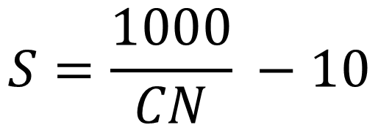
Getting Storage (S) from the Curve Number (CN)
$$S=\frac{1000}{CN} −10$$
Look CN up in a table. (https://en.wikipedia.org/wiki/Runoff_curve_number)
CN ranges from 30 (low runoff potential) to 100 (high runoff). Paved parking lots are 98.
It’s a function of land cover/vegetation and soil type
Can do a weighted average if several types within contributing area

Slide 33
Create a Unit Hydrograph Mini-Lab
Q1: For one inch of rainfall excess, what peak discharge would we expect to see from a medium density watershed with the following characteristics:
Area = 3 sq mi
Hydraulic Length = 1.2 miles
Average Slope = 3%
Land Cover: 1/3 Poor condition grass in Hydrologic Group A, 2/3 parking lot
Peaking Factor = 484
Q2: Use the provided spreadsheet to estimate discharge at time = 100 min
Q3: What should CN be to lower the peak cfs per inch of rainfall to 721?

Slide 34
SCS Method Tradeoffs
PROS
CONS
Computationally efficient
Can be adjusted with peaking factor, limb ratio, and CN to calibrate to observed data
Very widely used
Good for “quick checks”
Linearity assumption: assumes that 2” of rainfall excess produces a peak discharge twice as large as 1” of rainfall excess
Ie, response is independent of rainfall intensity
Ie, rainfall excess is uniformly distributed throughout the catchment.
No physical mechanisms represented. Cannot assign sensitivity in the model, if some condition changes in the watershed, won’t be able to calibrate
Assumes overland surface runoff

Slide 35
A Top-Down Model Example for Urbanized Watersheds
Premise: Do not assume CN, Peaking Factor, Land Cover/vegetation type, and instead look at the relationship between rainfall depth and average runoff depth for many storms, and across many watersheds.
Instead: characterize the relationship between rainfall depth and runoff depth, and see what watershed characteristics best explain nonlinearity

Slide 36
A Top-Down Model Example for Urbanized Watersheds
Motivation: Many assume that hydraulic connectivity in urbanized watersheds (ie, flashy response) is primarily determined by imperviousness preventing infiltration into subsurface. Is this true?

Slide 37
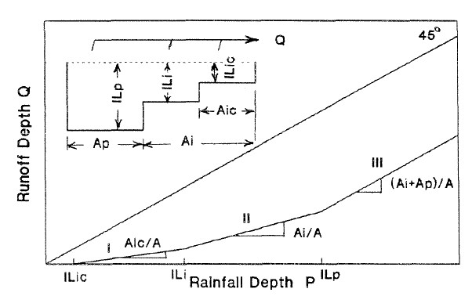
Simple Conceptualization of Changing Contributing Area
Boyd, et al 1994
Notes:
Explain the difference between Total Impervious Surface and Effective Impervious Surface
Hydraulic Connectivity

Slide 38
Simple Conceptualization of Changing Contributing Area
Boyd, et al 1994

Slide 39
Simple Conceptualization of Changing Contributing Area
Boyd, et al 1994

Slide 40
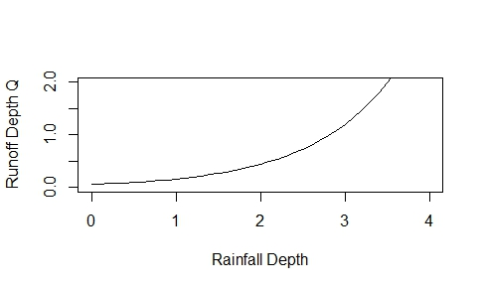
Nuance: probably more continuous

Slide 41
Nuance: probably more continuous

Slide 42
Nuance: probably more continuous

Slide 43
Nuance: probably more continuous

Slide 44
Nuance: probably more continuous

Slide 45
A Top-Down Model Example for Urbanized Watersheds
Non-linear response = less “flashy flows”. Contributing areas are becoming connected only as storm size increases; not all at once. (There is distributed “storage” in the watershed)
Logic:
Detect nonlinear response over many rainfall events for many catchments
Determine what factors best predict nonlinear response: is it low levels of impervious surface?

Slide 46
Detect nonlinear response over many rainfall events for many catchments
Determine what factors best predict nonlinear response: is it low levels of impervious surface?
Source: Lim, 2016

Slide 47
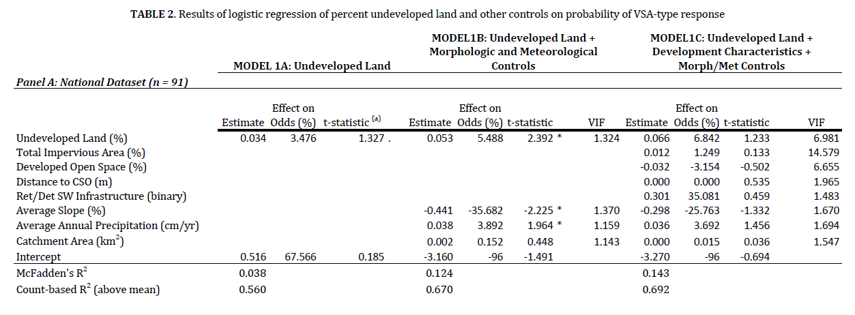

Slide 48
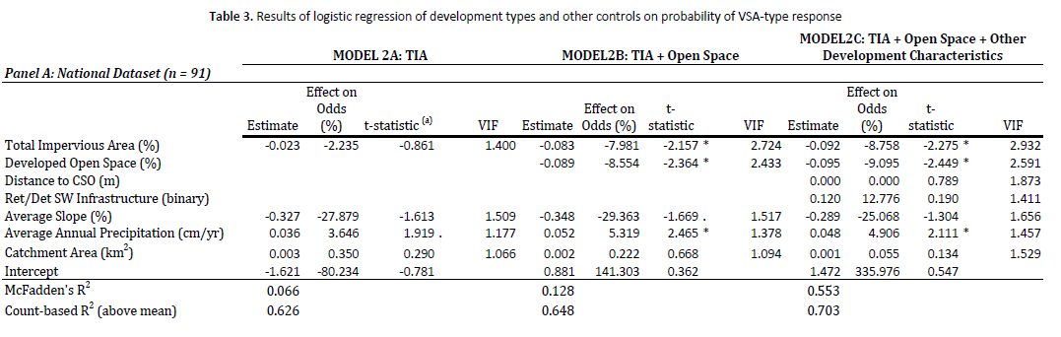
Percent Undeveloped is the Best Predictor of Incremental Storage in Watershed
Low density development functions more similarly to impervious surface than undeveloped land (why?)

Slide 49
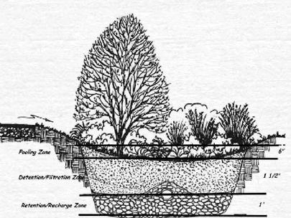
HydroCAD Demo: A Rain Garden
Note: HydroCAD is not a watershed model.
It is based on modeling “ponds”
The underlying premise is a “level” pool surface, or large stone/gravel filled structures.
We typically do not have that condition with rain gardens.
Have to develop work arounds.
Notes:
http://www.hydrocad.net/understanding.htm
http://www.hydrocad.net/exfilt.htm
https://www.youtube.com/watch?v=7sy-rZChHKY

Slide 50
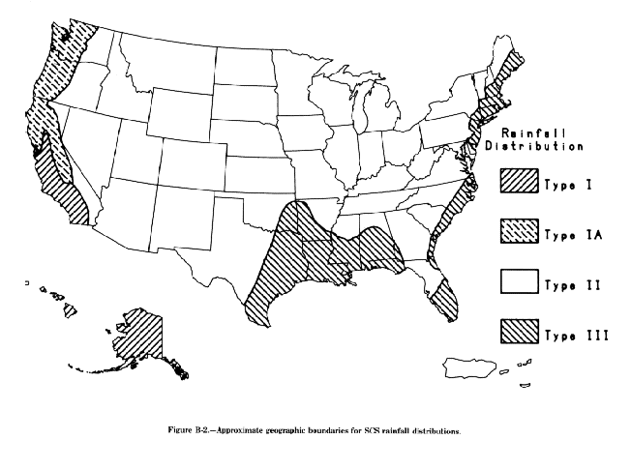
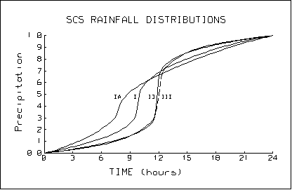
HydroCAD Demo: SCS 24h rain distributions

Slide 51
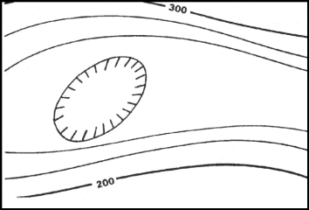
What to look for on a field site visit
Sheet flow, shallow channelized (Rule of Thumb, 300 ft) if raining
Mark breaklines – eg: retention wall, other sharp discontinuities in topography – dark black line
Look for evidence of soil erosion, mark on map – squiggly line. How to stabilize?
Mark local depressions, hills
Mark all downspout locations
Mark existing condition with (E)
Jot ideas for grading improvement with (P) or different color pen
If going during/right after rain, note where ponding occurs (X), depth, and why – blocked inlet? Pavement issue? Surface Grading? Compacted soil?

Slide 52
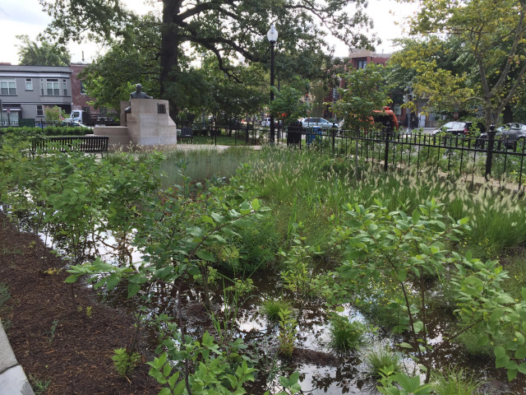
Other Design Thoughts
“Dear PoPville,
Just wanted to pass along a pretty disappointing photo. The Carter G. Woodson Park was recently completed in Shaw at a cost of over $1 million. It is a beautiful space and a great addition to the neighborhood. However, after every storm, a sizable portion of the park floods due to poor drainage. Many of the new plants are already showing damage. It is a shame that the landscapers didn’t anticipate this problem. Hopefully, it can be fixed soon and the park can live on for many years as it was intended.”
Ed. Note: When I first saw one of these giant puddles in Petworth years ago, I was confused too but was told it was perfectly normal that it was just a rain garden intended to collect water like this. Isn’t this same thing?
http://www.popville.com/2015/07/whats-up-with-the-giant-puddle-at-the-new-carter-woodson-park-in-shaw/

Slide 53
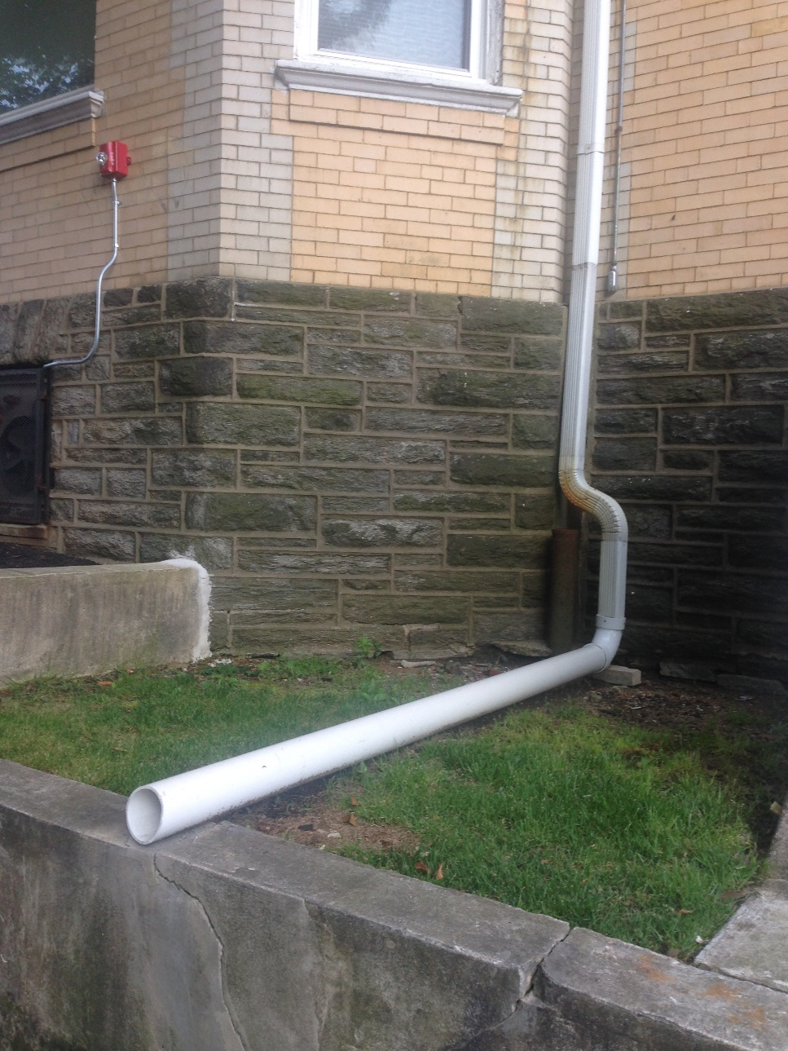
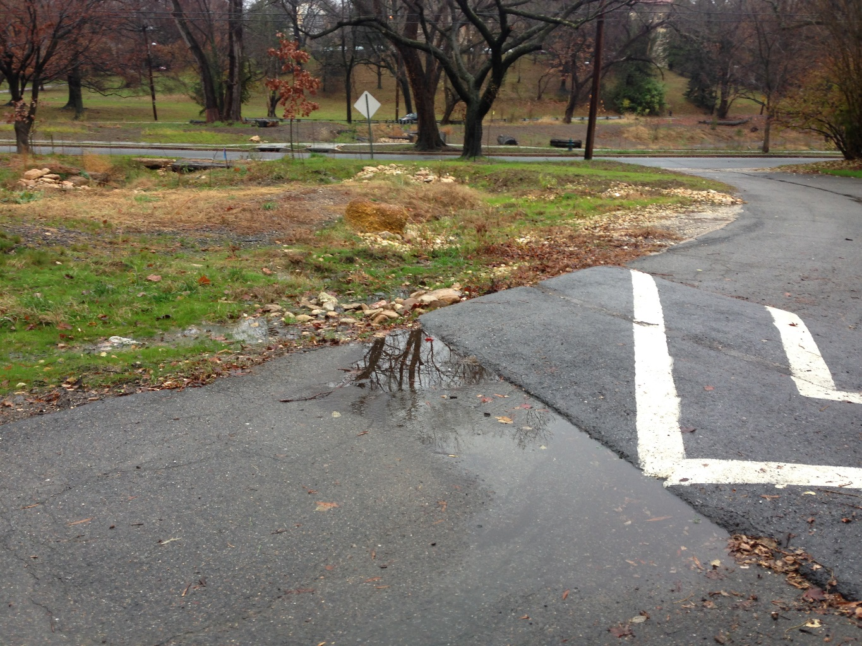
Other Design Thoughts
A speedbump berm
A “disconnected” downspout

Slide 54
Data Sources
Precipitation
- Many cities have their own rainfall gage networks. Can use Theissen polygons or spline methods to interpolate basin-averaged rainfall depths/intensities
- CoCoRaHS - citizen science – network of rainfall gages
- NOAA – NCDC – large network of airport-based rain gages
- NEXRAD – radar based (continuous, rather than discrete data points)

Slide 55
Data Sources
Flows
- Most large cities will have monitoring within sanitary sewer/separate sewer pipes very few monitor stormwater pipes
USGS stream gages – many are in urbanized watersheds
Soils/Subsurface
“Urban” soils = Who knows!? Important to get: permeability (hydraulic conductivity, and/or infiltration rates)
Groundwater table level
Bedrock? Clay lenses?
Vegetation
- Land cover type (NLCD ~ 30 m resolution) , anything better? Try UVM

